Slide 1

LEAD SUMMARY
AUG 2021
Updated: 9 Sept 2021

Slide 2
LEAD JAM Page Analytics
Divisional Uptake and Engagement
Status Overview
Division
Uptake
Engagement
Registration
Vs. last month
Automotive
57%
4%
Highest registration Ratio
Registered Users
368
Invited Users
643
Engaged Users
13
49%
1%
Retail
56%
7%
Total Registered Users
1,219 out of 2,495
Registered Users
366
Invited Users
655
Engaged Users
16
Engagement
Real Estate
48%
4%
Highest engagement Ratio
Registered Users
237
Invited Users
489
Engaged Users
9
4%
3%
Corporate
37%
5%
Registered Users
164
Invited Users
445
Engaged Users
8
Total Engaged Users 47
Orient
25%
3%
Lowest registration Ratio
JAM Collaboration Score
Registered Users
40
Invited Users
161
Engaged Users
1
61
1
points
HealthHub
43%
0%
Lowest engagement Ratio
Good
Invited Users
102
Engaged Users
0
Registered Users
44

Slide 3
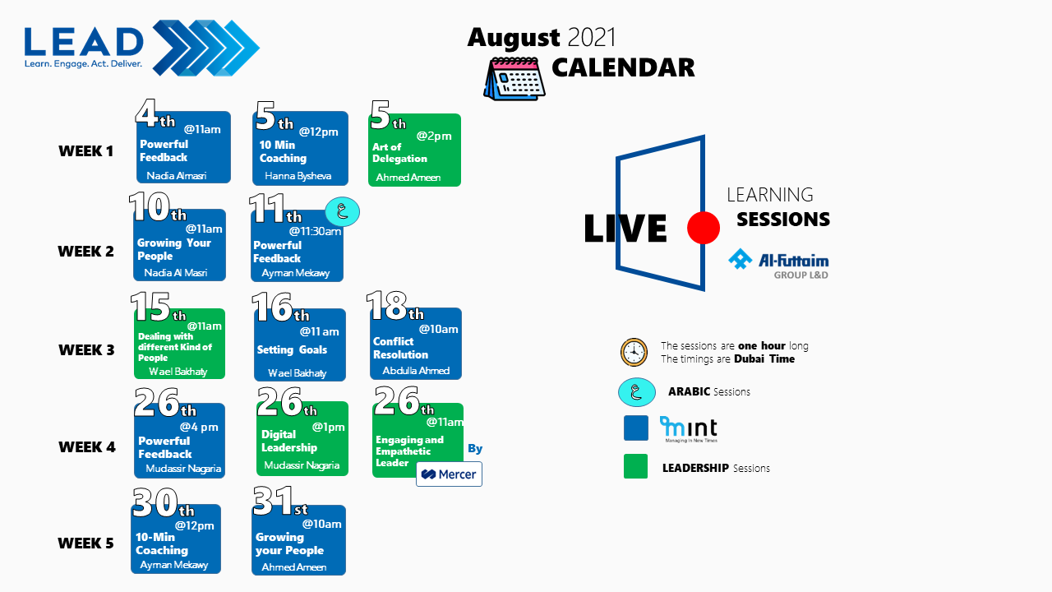
LEAD JAM Page Aug Content
Aug Theme: Cultural Transformation
 | # | Published Content | Clicked
Podcasts | 1 | Working from Home and Company Culture | 13
 | 2 | IKEA Navigates the Future While Staying True to Its Culture | 1
Trending | 1 | New Trends in Organizational Culture | 6
 | 2 | cultural-transformation/ | 3
 | 3 | Culture: 4 keys to why it matters | McKinsey & Company | 8
Leadership Tips | 1 | The Role of Cultural Change in Business and Digital Transformation | 1
 | 2 | The Fastest Way To Change A Culture | 11
Book | 1 | Change the Culture,Change the Game | 2
# | LIVE Sessions Delivered | Attended
Leadership LIVE Session | 2 | 73
MINT | 7 | 60

Slide 4

LEAD: LinkedIn Learning Utilization
Avg. min per user/month
# | March recommended Courses | Top Viewed*
1 | Leading Culture Change in Your Team
2 | Organizational Culture
3 | Business Benefits Realization Foundations
4 | Creating a Culture of Change
5 | Demystifying Company Culture
6 | Aaron Dignan on Transformational Change
7 | A Manager's Toolkit for Supporting Change
8 | Culture of Kaizen
36’
Total LinkedIn Learning Hours Utilized
This month | Total YTD
758 | 4656.39
LinkedIn Learning Course Completed
This month | Total YTD
2891 | 1678
*Out of those published and recommended on LEAD JAM Page
Notes:
Total LinkedIn Report for G+ employees --- INFO YTD
- Download only month and add. Top viewed to download YTD
Avg min per user –
(Total no. of hours viewed for all courses in NOV) *60 / Registered user
Jan – 18mins
Feb – 11mins
Mar -

Slide 5
Leadership Live Sessions Attendance*
Total Aug. Sessions
Total Sessions YTD
37
2
Aug. Avg. MLI L1
2
0
Total Attended YTD
1270
0
4.2
5
Calendar
Unique Topics
Arabic
369
Total Unique Attended YTD
Divisional Attendance
Total Attended Aug.
73
Total Entitled Managers |  |  | Attended Aug | Unique Aug
2631 | Auto | 673 | 23 | 20
 | Corporate | 474 | 2 | 2
 | Orient | 174 | 0 | 0
 | HealthHub | 121 | 0 | 0
 | Real Estate | 525 | 31 | 22
 | Retail | 664 | 17 | 16
Total Unique attended
Aug.
60
14%
Total Unique H/C coverage
Aug.
Target
2.3%
Total Unique H/C coverage YTD
* Band G & Above, MINT not included

Slide 6
Leadership LIVE Sessions MLI – L1
# | Aug 2021 Session | MLI – L1
1 | LEAD - Dealing with Different Kinds of People | 4.5
2 | LEAD - Digital Leadership | 4.0
# | July 2021 Session | MLI – L1
1 | Art of Thinking | 4.47
2 | Leveraging SuccessFactors to Engage your Employees | 4.77
3 | Obstacle Management | 4.27
4 | Peak Performance | 4.33
# | June 2021 Session | MLI – L1
1 | Digital Leadership | 4.38
2 | How Leaders Create and Use Networks | 4.30
3 | How to be a Better Manager 2.0 | 4.46
4 | Influencing Others | 4.56
5 | Leadership in Times of Crisis | 4.35
6 | Leading Change and How to Manage Conflicts | 4.54
7 | Think Big, How to talk Data | 4.17
# | May 2021 Session | MLI – L1
1 | How Leaders Create and Use Networks | 4.14
2 | Influencing Others | 4.47
3 | Leading with Emotional Intelligence | 4.67
4 | Using NLP for Enhancing Communication | 4.51
5
# | April 2021 Session | MLI – L1
1 | A Guide to Continuous Performance Management | 4.31
2 | Art of Praise | 4.51
3 | Curiosity: The Spark behind the Spark | 4.32
4 | Project Management in the New Normal | 4.49
5
# | March 2021 Session | MLI – L1
1 | Art of Thinking | 4.64
2 | Delegate Effectively and How to Make an Informed Decision | 4.14
3 | Managing Ambiguity and Uncertainty | 4.15
4 | Mastering Personal Connections | 4.50
5 | People, Culture and Business (Interview) | 4.30
Notes:
4- 5 green
3.1-3.9 – orange
Below 3 - red

Slide 7
Leadership AUG LIVE Sessions MLI – L1
Feedbacks
Dealing with Different Kinds of People
Digital Leadership
Wael had delivered the types of personalities successfully and how to deal with these different personalities .
Please continue to hold such learning which invigorates the brain cells
The programme was short and informative, interesting learnings within 24minutes.
I feel the session could have been a bit longer with some additional in-depth information about the topics. It was still informative and very interesting.

Slide 8
MINT Sessions Attendance*
Total Aug. Sessions
Total Sessions YTD
101
7
Aug. Avg. MLI L1
5
0
Total Attended YTD
809
0
4.4
5
Calendar
Unique Topics
Arabic
*MLI reflected is for previous month. No feedback received in July
609
Total Unique Attended YTD
Divisional Attendance
Total Attended Aug.
60
Total Entitled Employees |  |  | Attended Aug. | Unique Aug.
2631 | Auto | 676 | 20 | 10
 | Retail | 665 | 15 | 10
 | Real Estate | 528 | 21 | 11
 | Corporate | 467 | 4 | 2
 | Orient | 174 | 0 | 0
 | HealthHub | 121 | 0 | 0
Total Unique attended Aug.
33
23 %
Total Unique H/C coverage Aug.
Target
1%
Total Unique H/C coverage YTD
* Band G & Above, Leadership Sessions not included
Notes:
28% - target

Slide 9
MINT Sessions MLI – L1
# | August 2021 Session | MLI – L1
1 | Setting Goals | 0
2 | Coaching | 4.2
3 | Conflict Resolution | 0
4 | Powerful Feedback | 4.6
5 | Grow Your People | 0
6
# | July 2021 Session | MLI – L1
1 | Setting Goals | 4.8
2 | Coaching | 4.3
3 | Conflict Resolution | 4.3
4 | Powerful Feedback | 4.6
5 | Grow Your People | 4.4
6
# | June 2021 Session | MLI – L1
1 | Setting Goals | 4.18
2 | Coaching | 4.4
3 | Conflict Resolution | 0
4 | Powerful Feedback | 4.58
5 | Grow Your People | 4.52
6
# | May 2021 Session | MLI – L1
1 | Setting Goals | 4.4
2 | Coaching | 4.13
3 | Conflict Resolution | 4.25
4 | Powerful Feedback | 4.39
5 | Grow Your People | 4.18
6
# | April Session | MLI – L1
1 | Setting Goals | 4.3
2 | Coaching | 4.2
3 | Conflict Resolution | 4.4
4 | Powerful Feedback | 4.4
5 | Grow Your People | 4.3
6
# | March 2021 Session | MLI – L1
1 | Setting Goals | 3.9
2 | Coaching | 4.3
3 | Conflict Resolution | 4.4
4 | Powerful Feedback | 3.9
5 | Grow Your People | 4.3
6
Notes:
4- 5 green
3.1-3.9 – orange
Below 3 – red
1
Setting Goals
4.2
2
Coaching
4.5
3
Conflict Resolution
4.4
4
Powerful Feedback
N/A
5
Grow Your People
4.4
6
Interview for Fit
N/A

